Slide 1
CSE251: Electronic Devices and Circuits
Logic gates using BJT
Patially Prepared By:
Shadman Shahid (HAD)
Lecturer, Department of Computer Science and Engineering, School of Data and Sciences, BRAC University
Email: ext.shadman.shahid@bracu.ac.bd

Slide 2
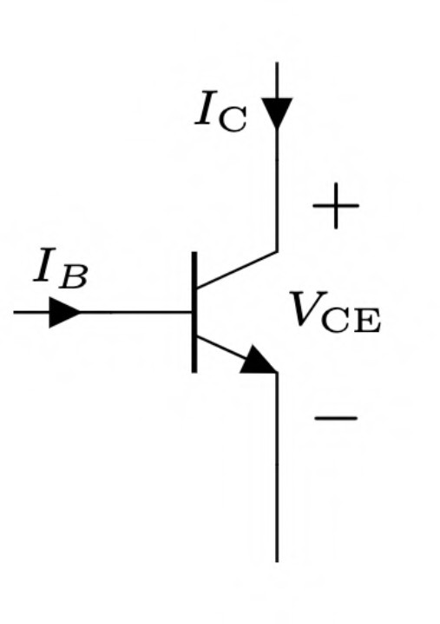
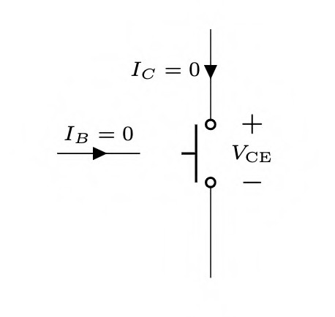
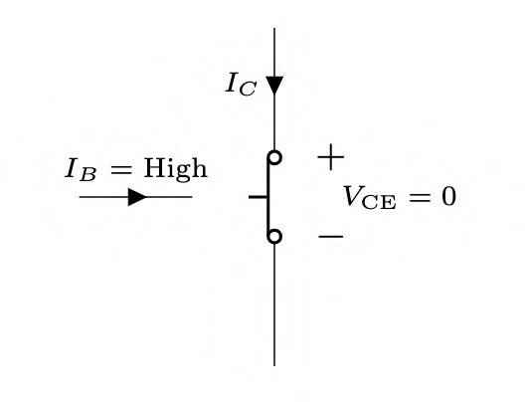



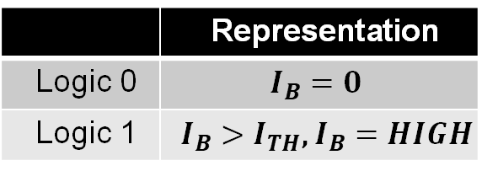

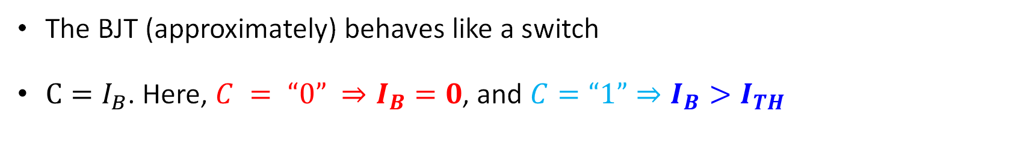


BJT S-Model
 | Representation
Logic 0 | $$I_{B}=0$$
Logic 1 | $I_{B}>I_{TH}$, $I_{B}=HIGH$
The BJT (approximately) behaves like a switch
$C=I_{B}$. Here, $C = “0” ⇒I_{B}=0$, and $C=“1”⇒I_{B}>I_{TH}$
$$I_{C}$$
$$I_{B}>I_{TH},$$
$V_{CE}=0$, short ckt
$$I_{B}=0$$
$I_{C}=0$, open ckt
$$V_{CE}$$

Slide 3
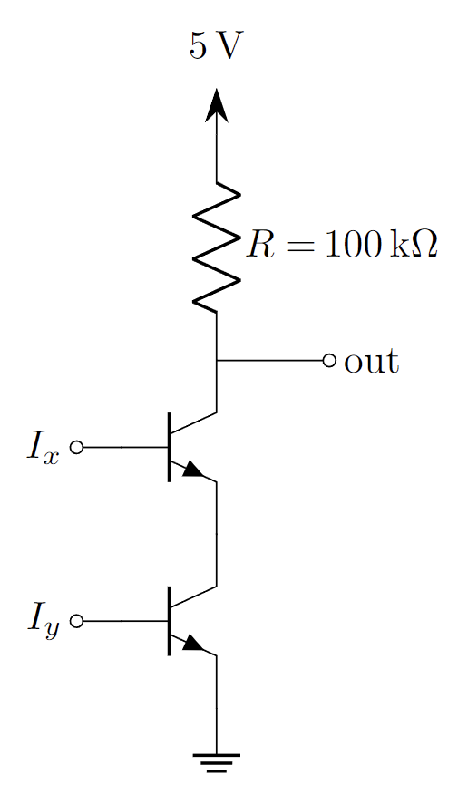
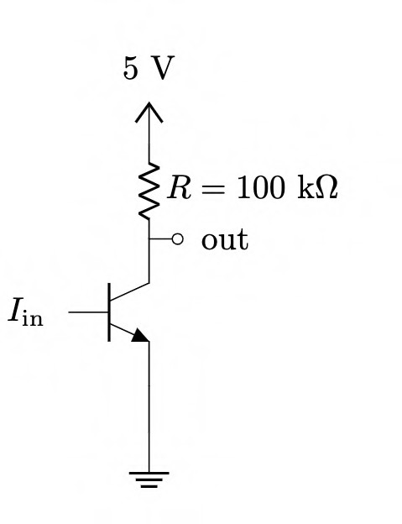
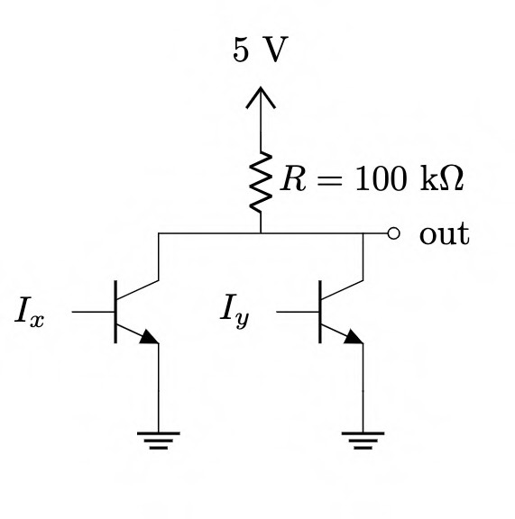
Current-Controlled Logic Gates using BJT
Just replace switches with BJTs!
Major problem: Cannot cascade! (Why?)
Input Logic Variable: Current
Output Logic Variable: Voltage
BJT Inverter (NOT Gate)
BJT NAND Gate
BJT NOR Gate

Slide 4
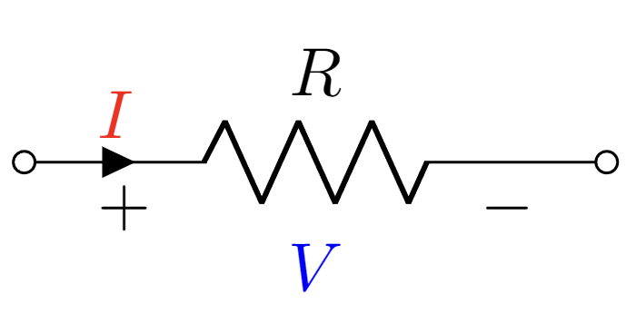
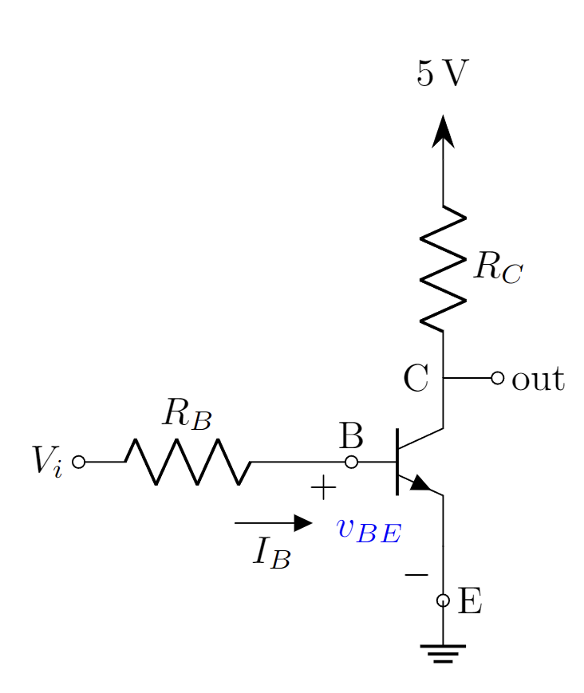
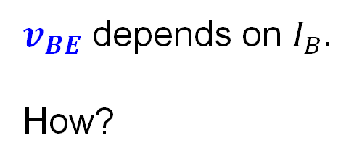
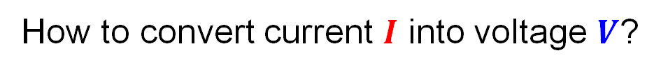
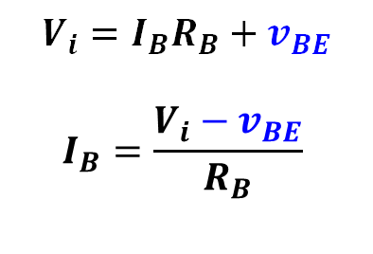
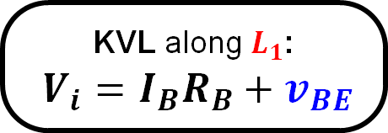

From Current Controlled to Voltage Controlled
How to convert current $I$ into voltage $V$?
$$V=IR$$
$$V_{i}=I_{B}R_{B}+v_{BE}$$
$$I_{B}=\frac{V_{i}−v_{BE}}{R_{B}}$$
$v_{BE}$ depends on $I_{B}.$
How?
KVL along $L_{1}$:
$V_{i}=I_{B}R_{B}+v_{BE}$

Slide 5




Logic Gates using BJT
Just replace switches with BJTs! – and add a Resistor to the Base terminal
Major problem: Cannot cascade! (Why?) Can be cascaded.
Input Logic Variable: Current Voltage
Output Logic Variable: Voltage
$$V_{x}$$
$$V_{x}$$
$$V_{y}$$
$$V_{y}$$
BJT Inverter (NOT Gate)
BJT NAND Gate
BJT NOR Gate

Slide 6
